Slide 1
CENG464 Text Mining
Hazim Alper ATA Ertuğrul DEMIR

Slide 2
Visual Inspection Of Data

Slide 3
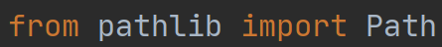
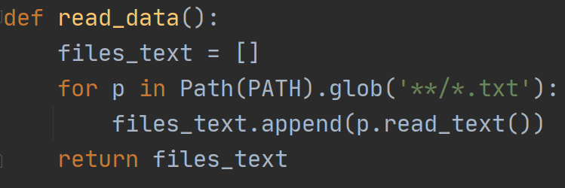
Reading & Preprocessing
array element = txt file
0-999 element = neg files
999-1999 element = pos files

Slide 4
Reading & Preprocessing
Punctuation
Word Tokenization
Removing Duplicate Letters
Removing Stopwords
Verb Lemmatization
Noun Lemmatization

Slide 5
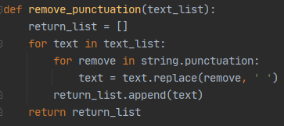
Reading & Preprocessing
Punctuation
Iterating every text, if they have a punctuation replace with space.
Ex: ‘plot : two’ => ‘plot two’

Slide 6
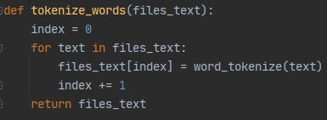
Reading & Preprocessing
2. Word Tokenization
Iterating every text in array, put text to word tokenize function. The data is converted to nested (2D) array.
Ex: ‘plot two teen couples’ => [ ‘plot’, ’two’, ’teen’, ’couples’ ]

Slide 7
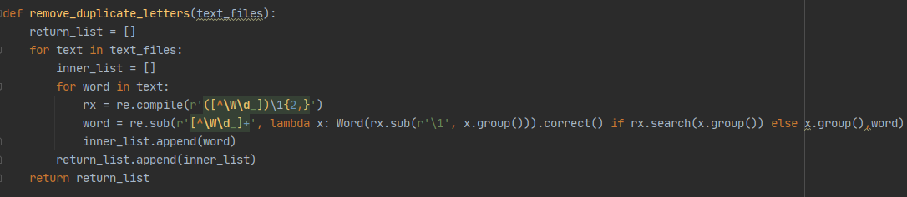
Reading & Preprocessing
3. Removing Duplicate Letters
Iterating every word in text array, recompile with regex.
Ex: ‘pllllleeeeease’ => ‘plleease’

Slide 8
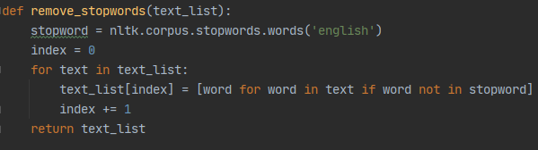
Reading & Preprocessing
4. Removing Stopwords
Iterating every text in array, recreated without stopwords.
Ex: [ ‘go’, ’to’, ’a’, ’church’ ] => [ ‘go’, ’church’ ]

Slide 9
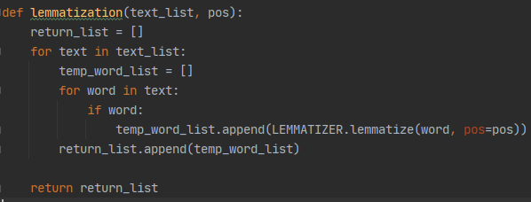
Reading & Preprocessing
5&6. Verb & Noun Lemmatization
Iterating every word in text array, recreated with lemmatized versions.
Verb Ex: [ ‘dy’] => [ ‘die’]
Noun Ex: [ ‘movies’,‘movie’] => [ ‘movie’, ’movie’ ]

Slide 10
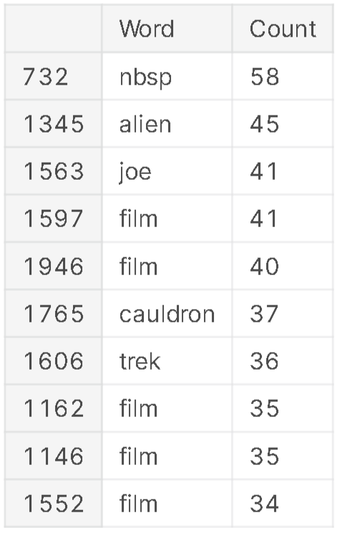
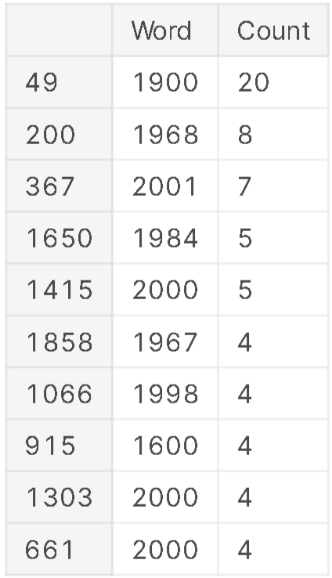
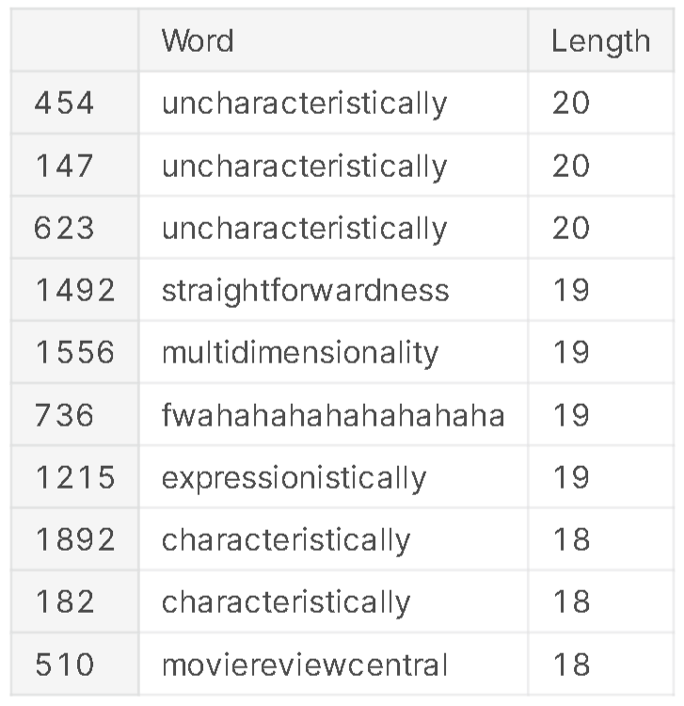
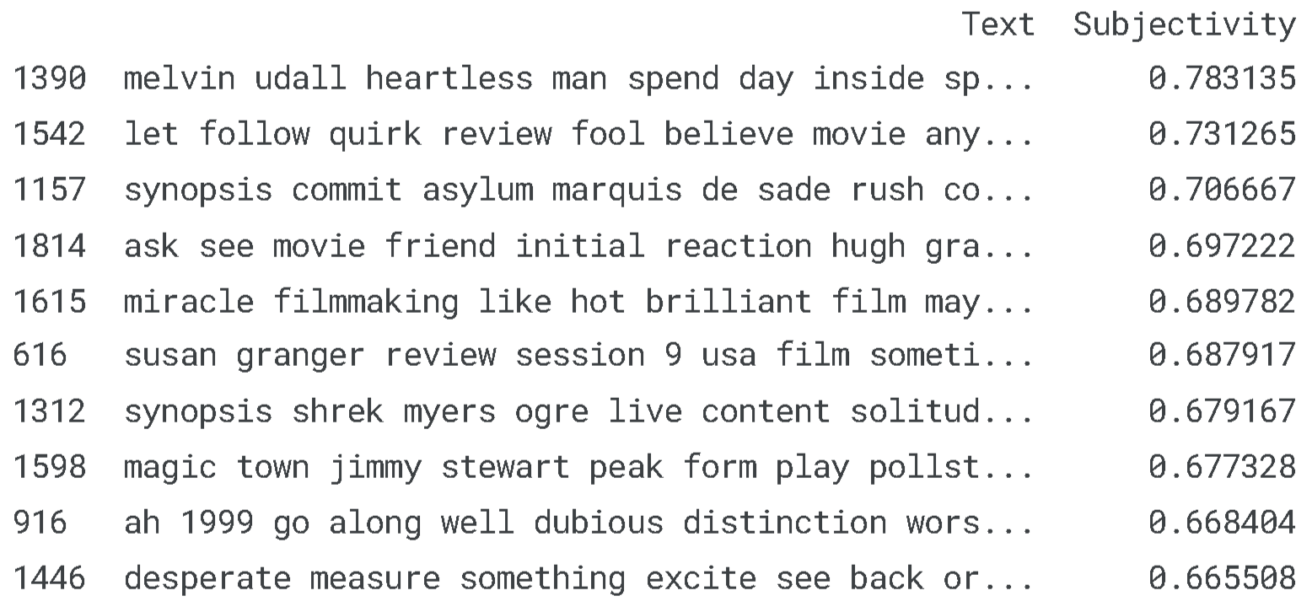
Different General Features
Word Counts in File
Year Counts in File
Longest Word in File
Subjectivity in File

Slide 11
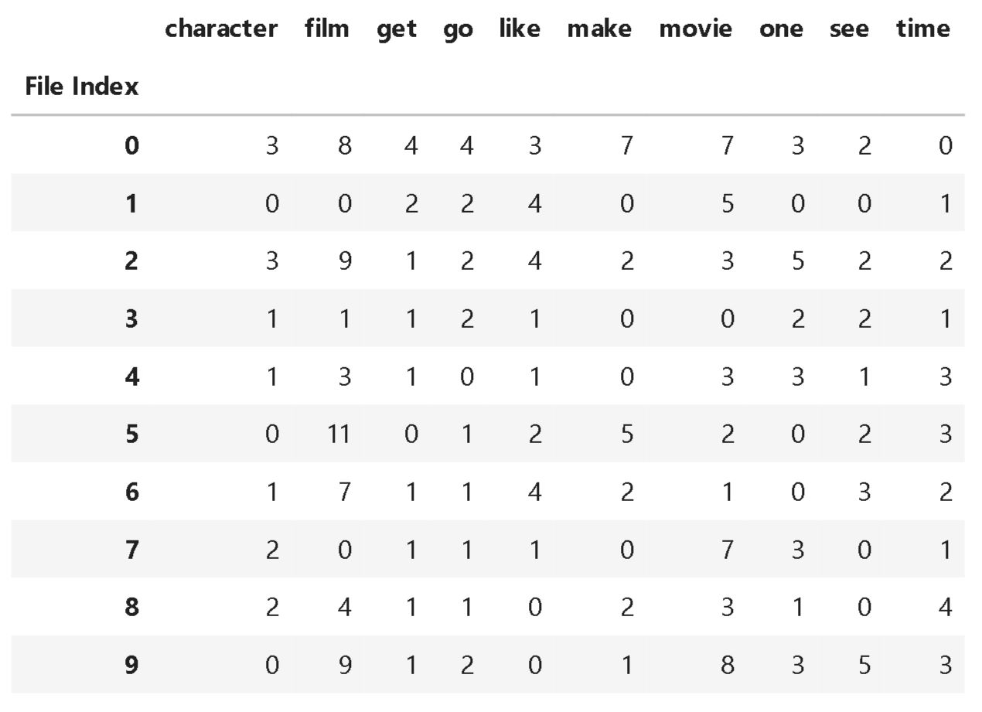
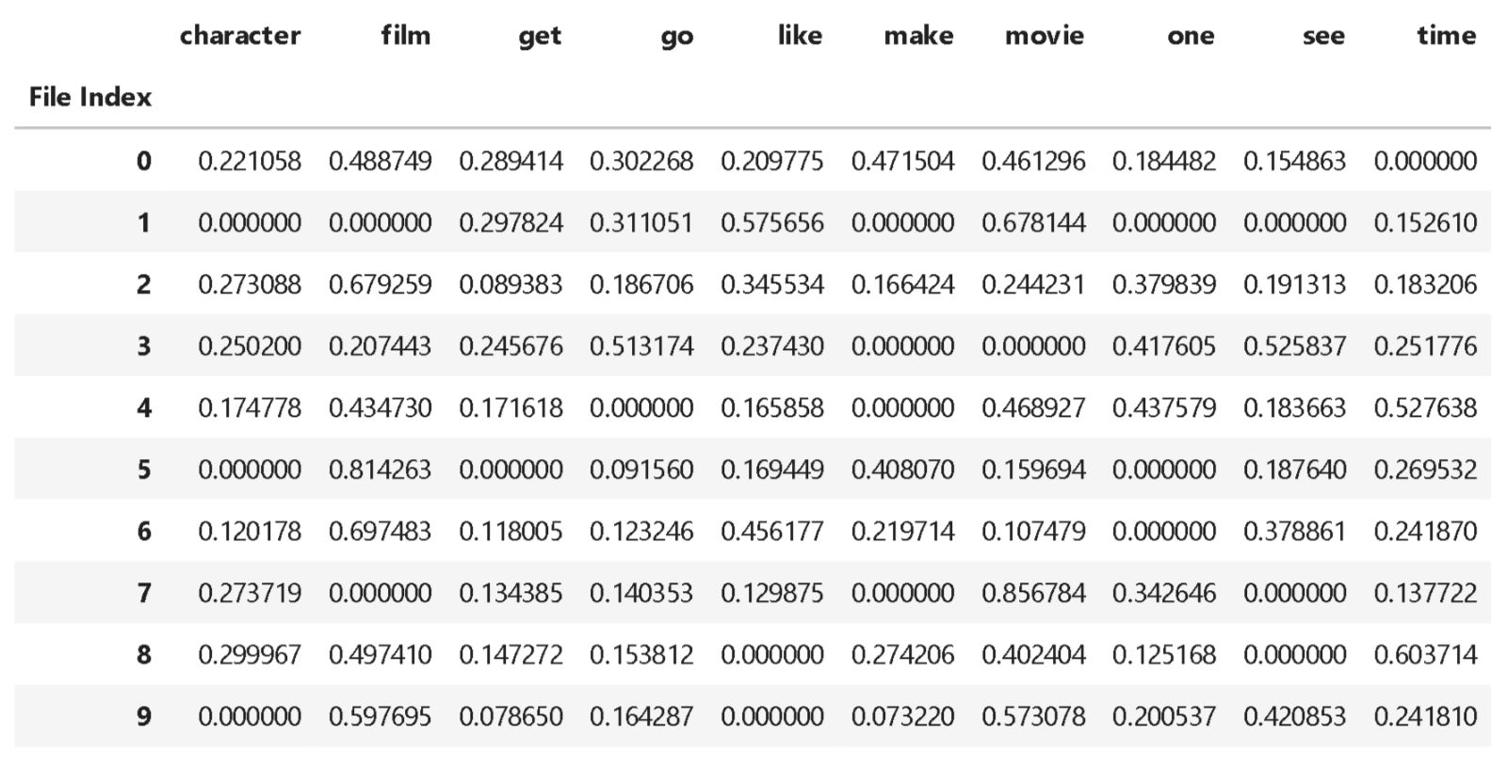
BoW vs TF-IDF
Bag of Words vectors are easy to interpret. However, TF-IDF usually performs better in machine learning models.
BoW
TF-IDF

Slide 12
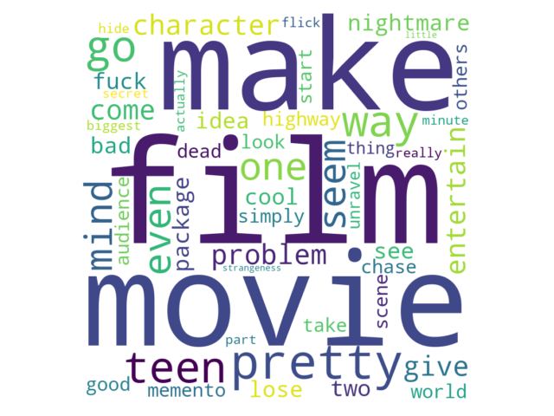
Word Cloud

Slide 13
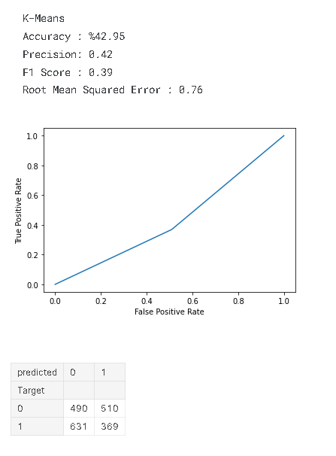
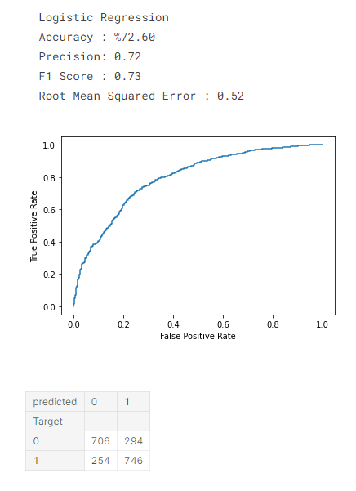
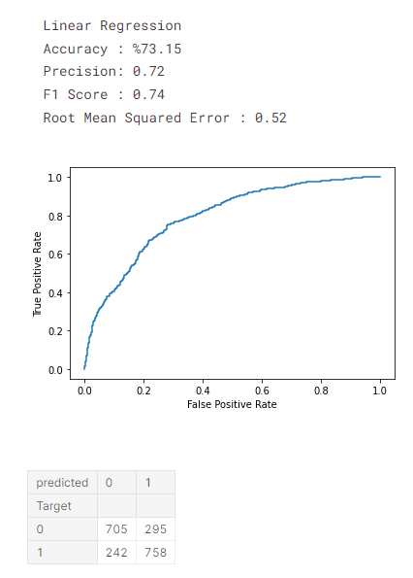
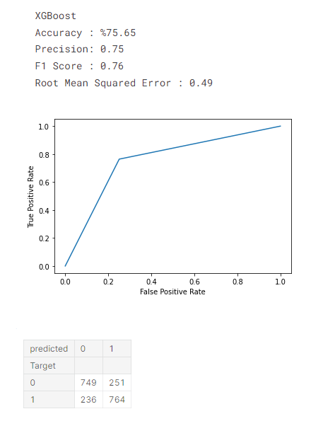
ML Models
K-Means
Logistic Regression
Linear Regression
XGBoost

Slide 14
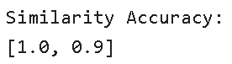
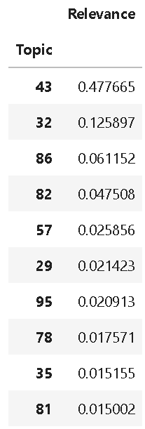
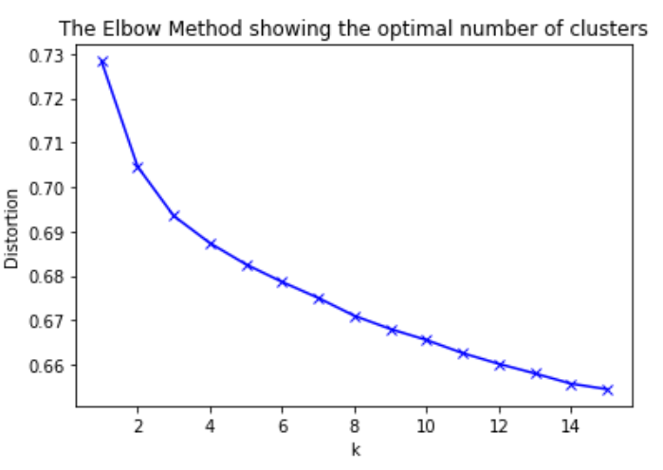
Topic Modelling -> LDA vs K-Means

Slide 15
Text Summarization
Preprocessing
Sent Tokenize
Punctuation
Tokenize Words
Remove Duplicate Letters
Stopwords
Lemmatization
Clean
Creating Sentence Vector
Creating Similarity Matrix
Creating Graph
Creating Summary
For neg and pos data frame template
File Index | Files | Sentences In Files | Words In Sentence | Sentence Vector | Similarity Matrix | Graph | Summary
….. | … | ….. | ….. | ….. | ….. | ….. | …..

Slide 16
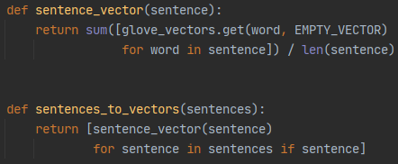
Text Summarization
2. Creating Sentence Vector
Iterating sentences and get vector from glove vectors.

Slide 17
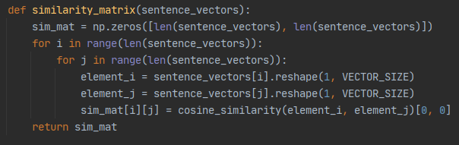
Text Summarization
3. Creating Similarity Matrix
Iterating sentence vector and calculating their similarity with cosine similarity. Return nested (2D) array.

Slide 18
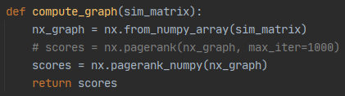
Text Summarization
4. Creating Graph
Iterating sim matrices and getting their graphs. With pagerank we get their scores.

Slide 19
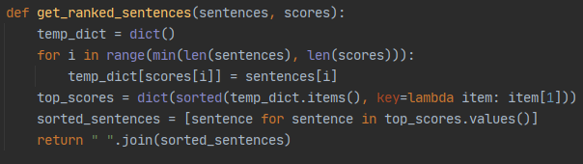
Text Summarization
5. Creating Summary
Iterating sentences with their scores together, create a dictionary and sort it.

Slide 20
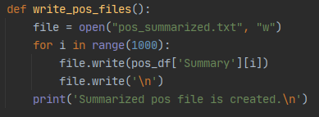
Text Summarization
Writing
Iterating in range and getting their summary to text file. Each line equals a text file.

Slide 21
Log. Reg. TF-IDF: 80.1%
Log. Reg. BoW: 64.2%
Random Forest TF-IDF: 76.8%
DTC TF-IDF: 62.6%
Sentiment Analysis
Best Estimator = Pipeline(steps=[('vect', TfidfVectorizer(lowercase=False)),
('log_reg', LogisticRegression(C=200, random_state=0))])
Score= 83%
The model has a test accuracy of 85.6%

Slide 22

Thanks!

